Slide 1

Scenario 3 - Skydive
Alberta “Albi” Kovatcheva

Slide 2
Scenario
An aerospace medicine doctor wants to know how heart rates differ for Airmen from the beginning to the end of their skydiving jump. She has recorded heart rate data by timepoint in this dataset.

Slide 3
Hypothesis Testing
For this scenario, I conducted a dependent t-test, because the doctor wants to compare the airmen's’ heart rate before and after skydiving.

Slide 4
Hypotheses
Null Hypothesis (H0): There will be no difference in the airmen’s heart rate before and after skydiving.
Alternative Hypothesis (H1): There will be a difference in the airmen’s heart rate before and after skydiving.

Slide 5
Requirements for t-Tests
The t-test requires that the dependent variable is approximately normally distributed within each group.

Slide 6
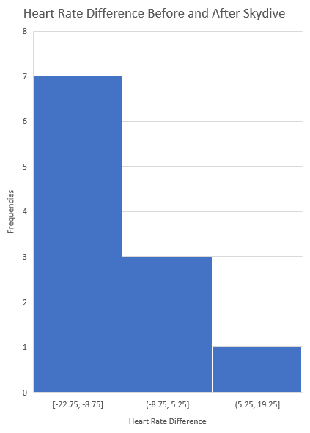
Verifying t-test Requirements
The dependent variable does not appear normally distributed. Therefore, the requirement for this t-test has not been met. However, I am proceeding with the testing for the purposes of this activity.

Slide 7
Descriptive Statistics
 | Results of t-Test
Test statistic (t) | -3.446316177
P-value | 0.006264734
 | Calculations for t-Test
Before mean | 76.91
After mean | 86.18
Difference | -9.27
Sample Size | 11
Standard Deviation | 8.921152
Standard error of the difference | 2.689829
Cohen’s d | -1.0391
Degrees of freedom | 10

Slide 8
Conclusions
P = 0.006264734 & alpha = 0.05
P < 0.05
Therefore, there is enough evidence to reject the null hypothesis.
This means that there is a difference between the airmen's heart rate before and after skydiving.
After mean > Before mean
Perhaps, skydiving increases the airmen’s heart rate.
Cohen’s d = -1.0391 < 0.2
Although the average difference between the airmen’s heart rate is significant, the difference is statistically negligible.
However, there is an overall increase in the airmen’s heartrates after skydiving.

